Slide 1
METAMODELING AND MODEL TRANSFORMATIONS IN MODELING AND SIMULATION
Deniz Cetinkaya, Alexander Verbraeck
Presented by
Tamanna Sultana Tonu
ID: 19101155
Course: CSE474
Section:01

Slide 2
INTRODUCTION
Models as Primary Artifacts
Metamodeling for Formal Definitions
Model Transformations for Reuse
Different Views of the System
MDD in Modeling and Simulation

Slide 3
BASIC MDD CONCEPTS
Metamodeling
Components of a Modeling Language
Metamodeling for DSMLs
Metamodeling Hierarchy
Common Metamodeling Languages
Model Transformations
Model Transformation Process
Endogenous vs. Exogenous Transformations
Types of Model Transformations
M2M and M2T Transformations
Popular Model Transformation Languages

Slide 4
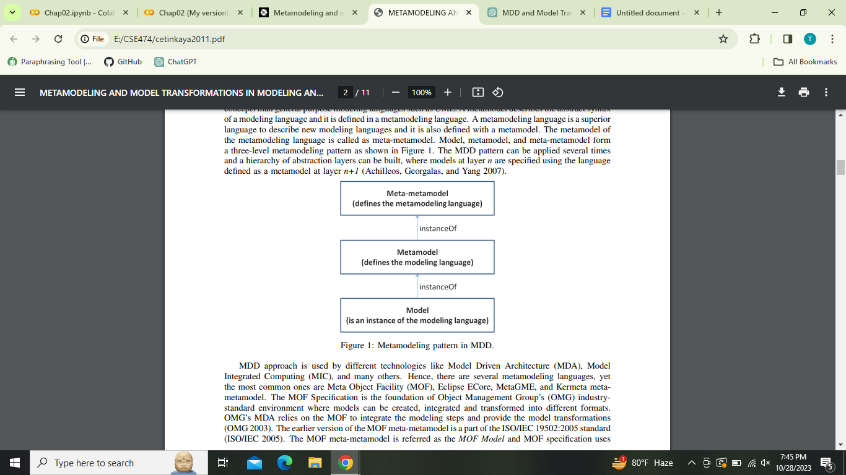
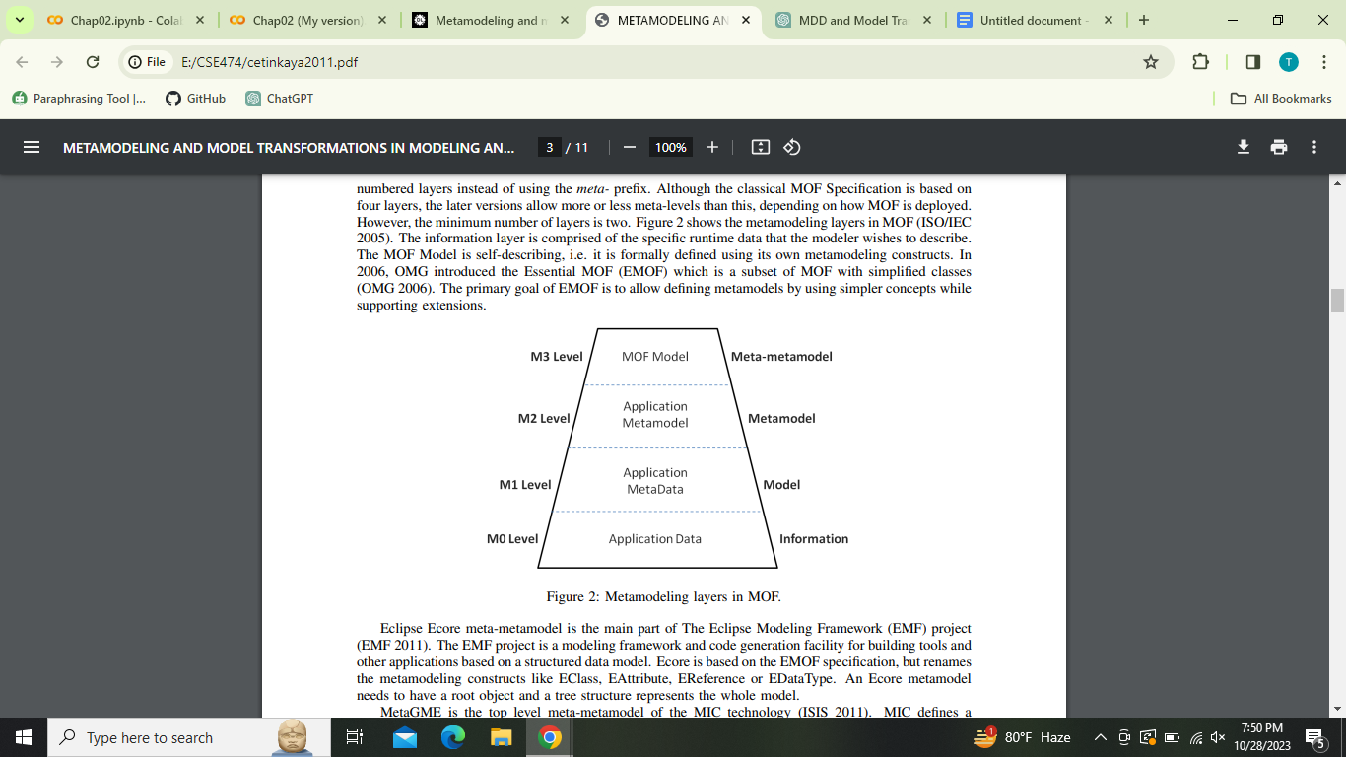

Slide 5
MDD APPLIED INTO SIMULATION
MDD in Simulation
Applications of MDD in Simulation
Benefits of MDD in Simulation
MDD4MS Framework
Challenges and Open Problems

Slide 6
CRITERIA FOR MODEL TRANSFORMATIONS
Evaluation Criteria for Model Transformations
Importance of Criteria
Varied Approaches to Model Transformations

Slide 7
CONCLUSION
Selecting the Right Languages and Tools
Future Research in MDD Based on Proposed Criteria

Slide 8
REFERENCE
Metamodeling and model transformations in modeling and simulation | Proceedings of the Winter Simulation Conference

Slide 9
THANK YOU

